Slide 1
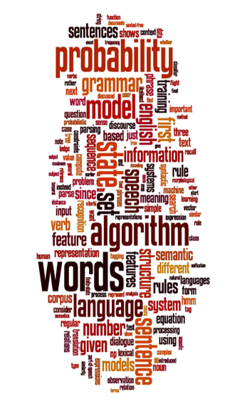
Automobile Brand Analysis: Text Mining

Slide 2

Introduction
Microblogging has become popular communication tool
A major benefit of social media is that we can see the good and bad things people say about the particular brand or personality.
The bigger your company gets difficult it becomes to keep a handle on how everyone feels about your brand. For large companies with thousands of daily mentions on social media, news sites and blogs, it’s extremely difficult to do this manually.
To combat this problem, sentimental analysis. It can be used to evaluate the people's sentiment about particular brand or personality.
People’s opinions towards a brand have huge impact on its success.

Slide 3
Brief
Understanding the perception of the brand in the digital space
Competitors presence in social media
Classifying the social mentions!
Identifying the patterns
Bottle Necks :-
Tweets are highly unstructured and also non-grammatical
Out of Vocabulary Words , Lexical Variation & extensive usage of acronyms .
High volume of positive/negative response may indicate status quo of a brand . But how to quantify ?

Slide 4





Approach
Web Scrapping/Fetching Data
Tokenization
Preprocessing
Feature Extraction
Implement Machine Learning techniques
Notes:
Tweet Downloader
Download the tweets using Twitter API
Tokenisation
Twitter specific POS Tagger developed by ARK Social Media Search
Preprocessing
Removing non-English Tweets
Replacing Emoticons by their polarity
Remove URL, Target Mentions, Hashtags, Numbers.
Replace Negative Mentions
Replace Sequence of Repeated Characters eg. ‘coooooooool’ by ‘coool’
Remove Nouns and Prepositions
Feature Extractor
Polarity Score of the Tweet
Percentage of Capitalised Words
Number of Positive/Negative Capitalised Words
Number of Positive/Negative Hashtags
Number of Positive/Negative/Extremely Positive/Extremely Negative Emoticons
Number of Negation
Positive/Negative special POS Tags Polarity Score
Number of special characters : ?,!,*
Number of special POS
Classifier and Prediction
The features extracted are next passed on to SVM classifier.
The model built is used to predict the sentiment of the new tweets

Slide 5
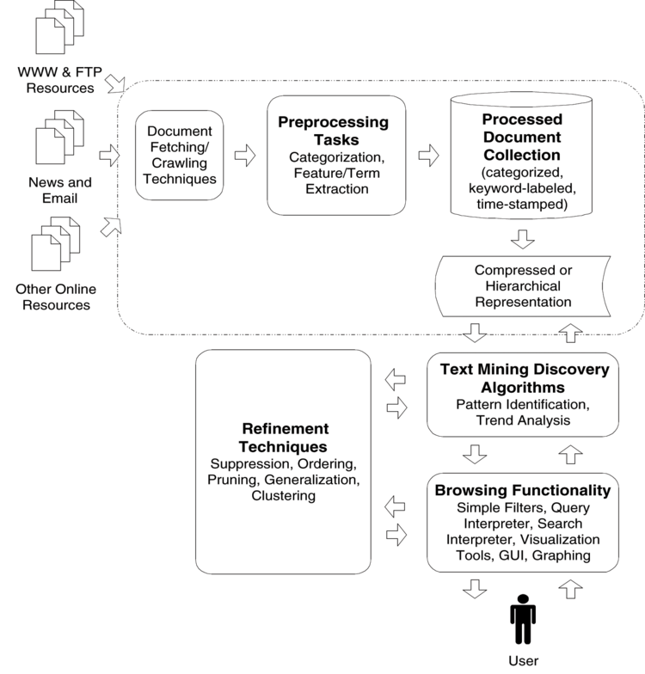
Architecture

Slide 6
Deliverables
Superior brand recall
Brand Loyalty
Better customer service
Getting better in the market share
Creating goodwill

Slide 7
Resources
Data Set sources:
Data set provided by Aegis
Data from Web Scraping
Software's:
R
Python
Machine Learning Techniques
Hadoop
Microsoft Office

Slide 8
References
http://cs229.stanford.edu/proj2014/Wen%20Zhang,%20Geng%20Zhao,%20Chenye%20Zhu,%20Mood%20Detection%20with%20Tweets.pdf

